Slide 1

WEB APPLICATION LYON AUTOSIB SERVICE
FINAL PROJECT

Slide 2

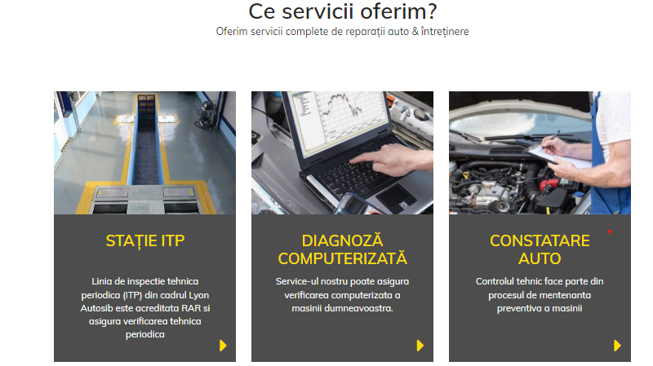
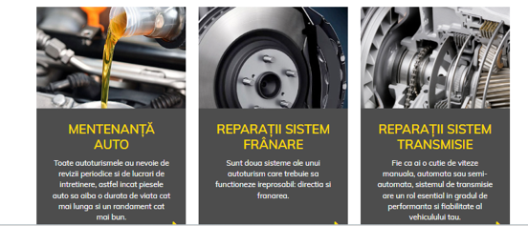
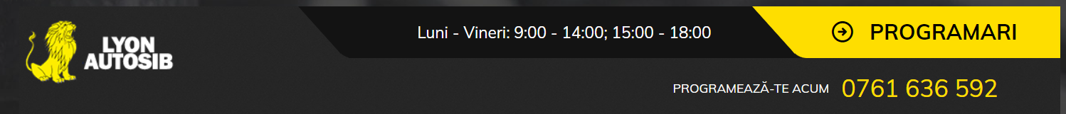
APP DESCRIPTION
LYON AUTOSIB SERVICE
a presentation website for a company that provides services for a complete car repair and maintenance.
the possibility of making appointments online.

Slide 3
TESTING APPROACH
Ad-hoc Testing to decide if the web application is worth further testing;
Exploratory Testing for main functionalities;
Document the Exploratory Testing, designed detailed test cases that include input data, expected results, and the steps to execute the test;
Run the designed test cases by manually testing;
Write the Smoke tests and execute them;
Record the results of each test, noting whether the actual results match the expected results;
Bug Reporting: provide clear and detailed information about each issue, including steps to reproduce and the expected vs. actual outcomes;
Write the Test Report

Slide 4




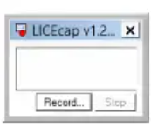
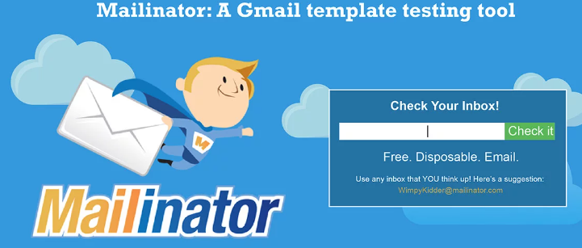

TOOLS USED
Microsoft Excel - documenting test cases, test data, and tracking test execution progress
MantisBT - bug tracking
Snipping Tool - screenshots capture
LICEcap - capture an area of your desktop and save it directly to .GIF
Mailinator - test emails
Google Chrome browser
Xmind - mind maps

Slide 5
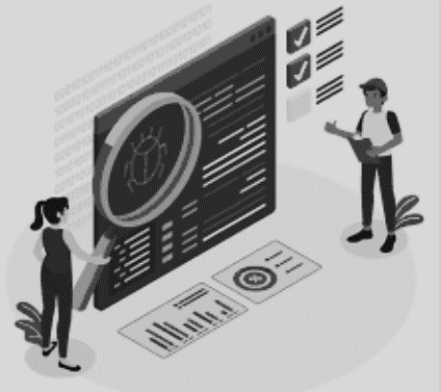
TESTING TYPES COVERED
Smoke Testing
Negative Testing
Ad-Hoc testing
Positive Testing
End-to-end testing
Compatibility Testing
Exploratory
Testing

Slide 6
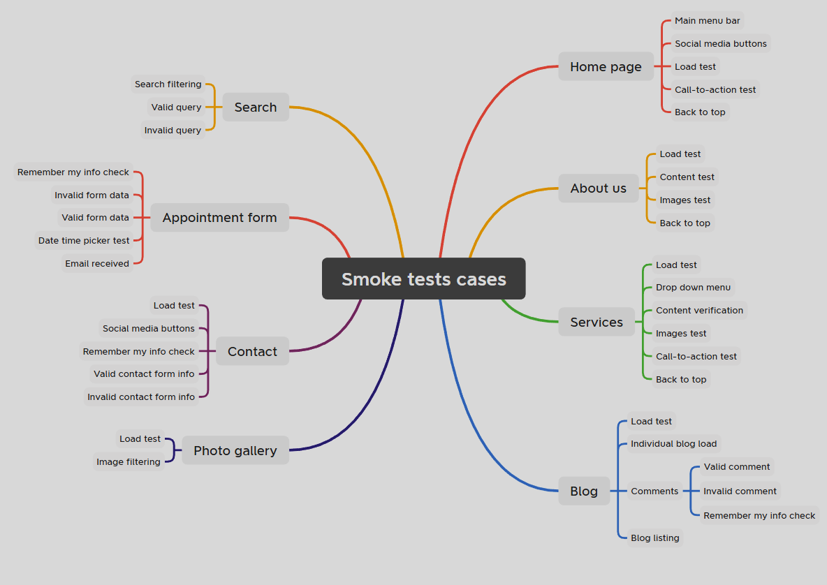
TEST CASES OVERVIEW
8
5
4
12
10
13
4
10
TOTAL: 66 TEST CASES

Slide 7

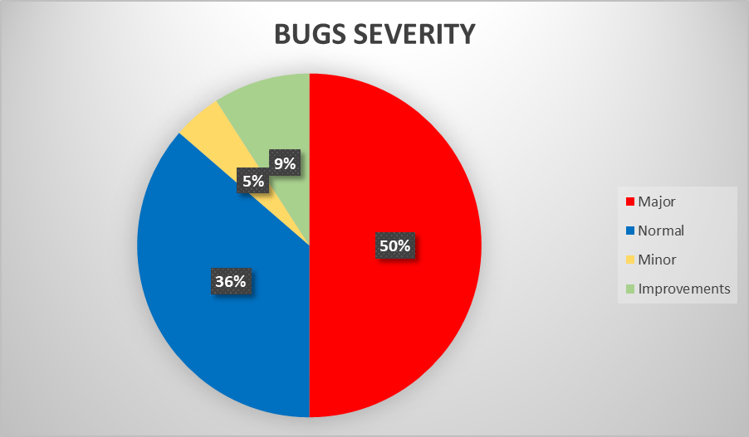
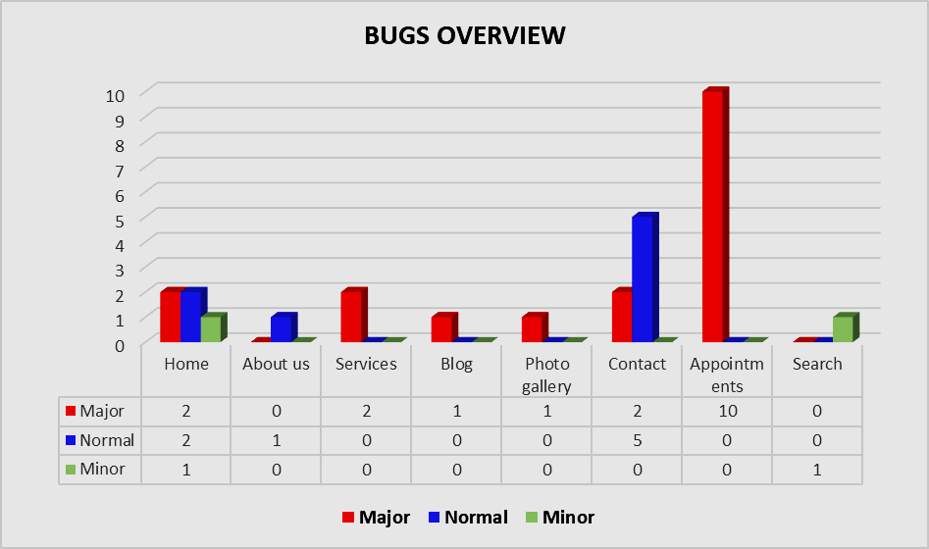
BUGS OVERVIEW

Slide 8
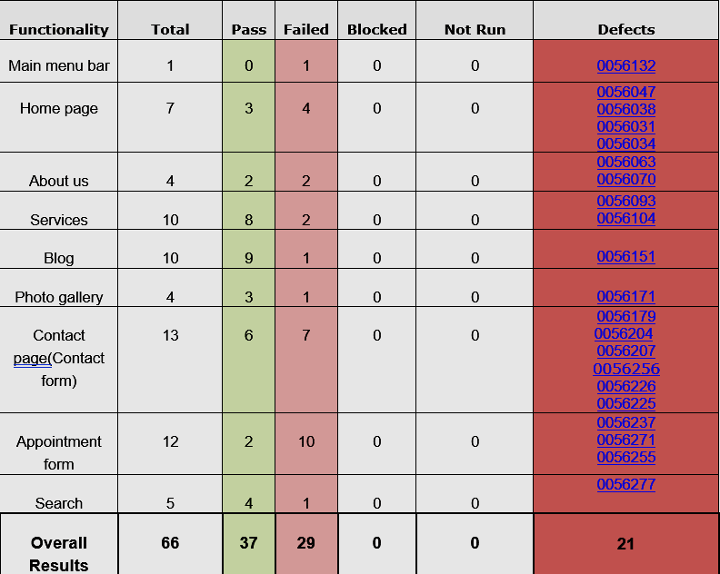
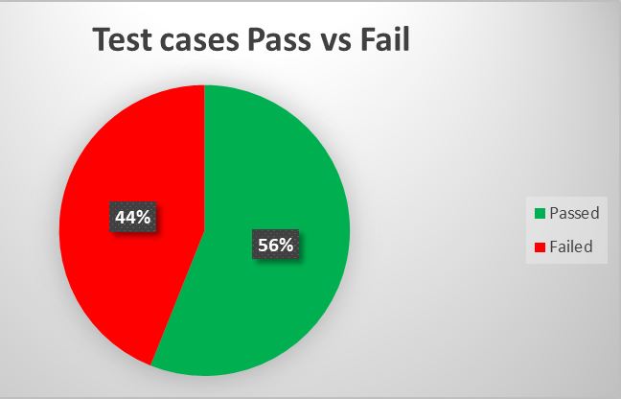
TEST CASES RESULTS

Slide 9
CONCLUSIONS
Smoke testing was performed on this website for the main functionalities and we have the following result: 56% of the test cases performed are passed and the remaining 44% are failed.
In addition to the Smoke and Exploratory tests performed for the main functionalities, also other types of testing were used: Compatibility testing, Ad-Hoc testing, End-to-end testing, Positive testing and Negative testing.
A total of 29 bugs were identified and also 2 improvements. All identified bugs are still open and half of them are of major severity.
One of the main functionalities of the website, like the Appointments form is not working, this is critical in actually testing this functionality, the main purpose of this form is to be able to make appointments online.
We tested version 1.0, most tests were performed on the following test environment devices and browsers: Laptop ASUS TUF Gaming F15, Windows 11 Pro, Mobile Samsung Galaxy A54, Android version: 14, Google Chrome.
Based on the extended Smoke testing performed on the website LYON AUTOSIB SERVICE, reveals several major issues that affect it’s main features and that would result in decreased user retention, therefore the website’s main scope, to bring new clients to the service, will be heavily affected.
In conclusion, all major and normal defects should be checked and closed before release.
Not yet ready for relased !

Slide 10

LESSONS LEARNED
Lack of requirements can make testing a web application difficult.
It is necessary to include several types of testing to have the desired result at the end.
As a tester, sometimes we need to use intuition as a guide, not justification.
As a tester, we need to think technically, creatively, critically and practically.

Slide 11


